Slide 1
Systems Analysis and Design 10th Edition
ToolKit C– The Systems Analyst’s Toolkit – Financial Analysis Tools

Slide 2
Chapter Objectives
Define economic feasibility
Classify costs and benefits into various categories, including tangible or intangible, direct or indirect, fixed or variable, and developmental or operational
Understand chargeback methods and how they are used

Slide 3
Chapter Objectives
Use payback analysis to calculate the length of time that it takes for a project to pay for itself
Use return on investment analysis to measure a project’s profitability
Use present value analysis to determine the value of a future project measured in current dollars

Slide 4
Describing Costs and Benefits
As a systems analyst, you must review a project’s costs and benefits at the end of each SDLC phase so management can decide whether or not to continue the project
Before you can use the economic analysis tools described in this section of the Toolkit, you must learn how to identify and classify all costs and benefits

Slide 5
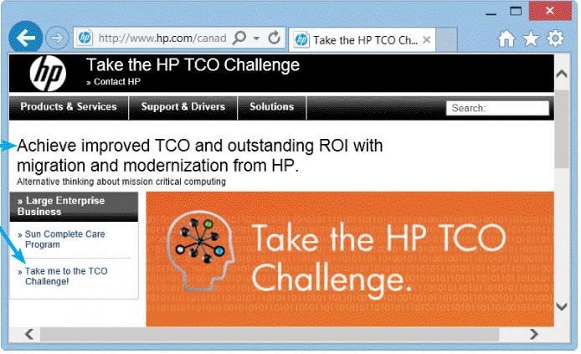
Describing Costs and Benefits (Cont.)
Cost Classifications
Costs can be classified as tangible or intangible, direct or indirect, fixed or variable, and developmental or operational
FIGURE TK C-3 HP invites visitors to try a free TCO Challenge in order to improve TCO and return on investment (ROI)

Slide 6
Describing Costs and Benefits (Cont.)
Tangible
Costs for which you can assign a specific dollar value
Examples include employee salaries, hardware and software purchases, and office supplies
Intangible
Costs whose dollar value cannot be calculated easily
Examples are the cost of customer dissatisfaction, or lower employee morale

Slide 7
Describing Costs and Benefits (Cont.)
Direct Costs
Costs that can be associated with the development of a specific system
Examples include the salaries of project team members and the purchase of hardware that is used only for the new system
Indirect Costs
Also called overhead expenses - cannot be attributed to the development of a particular information system
Examples are the salaries of network administrators, copy machine rentals, and insurance expenses

Slide 8
Describing Costs and Benefits (Cont.)
Fixed Costs
Costs that are relatively constant and do not depend on a level of activity or effort
Examples are salaries and hardware rental charges.
Variable costs
Costs that vary depending on the level of activity
Examples are the costs of printer paper, supplies, and telephone charges

Slide 9
Describing Costs and Benefits (Cont.)
Developmental Costs
Costs that are incurred only once, at the time the system is developed or acquired
Examples include salaries of people involved in systems development, software purchases, initial user training, and the purchase of necessary hardware or furniture
Operational costs
Costs incurred after the system is implemented and continue while the system is in use
Examples include system maintenance, ongoing training, annual software license fees, and communications expense

Slide 10
Describing Costs and Benefits (Cont.)
Some costs apply to more than one category of expenses
Overtime pay for clerical staff during the systems analysis phase would be classified as developmental, variable, and direct
A monthly fee for maintaining the company’s Web site would be regarded as operational, fixed, and indirect
Managing Information Systems Costs and Charges
Direct costs usually are easier to identify and predict than indirect costs

Slide 11
Describing Costs and Benefits (Cont.)
Managing Information Systems Costs and Charges (Cont.)
A chargeback method is a technique that uses accounting entries to allocate the indirect costs of running the IT department
Most organizations adopt one of four chargeback methods:
No charge
A fixed charge
A variable charge based on resource usage
A variable charge based on volume

Slide 12
Describing Costs and Benefits (Cont.)
Benefit Classifications
Like costs, benefits can be classified as tangible or intangible, fixed or variable, and direct or indirect
Positive benefits increase revenues, improve services, or otherwise contribute to the organization as a direct result of the new information system
Cost-avoidance benefits refer to expenses that would be necessary if the new system were not installed

Slide 13
Cost-Benefit Analysis
Payback Analysis
The process of determining how long it takes an information system to pay for itself
The time it takes to recover the system’s cost is called the payback period
To perform a payback analysis:
1. Determine the initial development cost of the system
2. Estimate annual benefits.
3. Determine annual operating costs.
4. Find the payback period by comparing total development and operating costs to the accumulated value of the benefits produced by the system

Slide 14
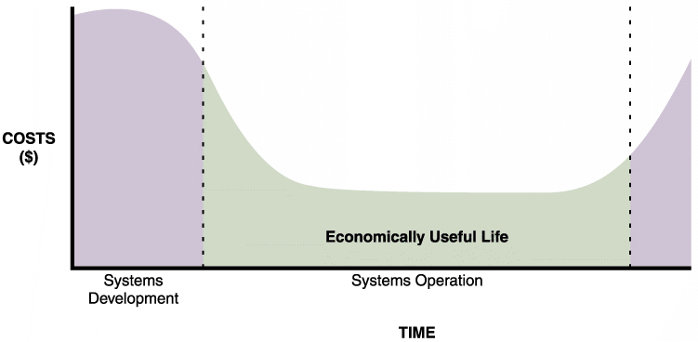
Cost-Benefit Analysis (Cont.)
FIGURE TK C-5 The costs of a typical system vary over time. At the beginning, system costs are high due to initial development expense. Costs then drop during systems operation. Maintenance costs begin to increase until the system reaches the end of its economically useful life. The area between the two dashed lines shows the economically useful life of this system

Slide 15
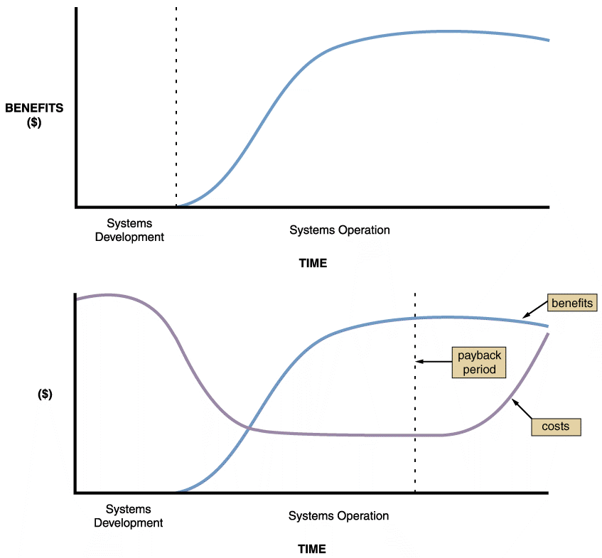
Cost-Benefit Analysis (Cont.)
FIGURE TK C-6 Benefits of an information system change over time, as shown in the upper graph. The lower graph shows costs and benefits plotted on the same graph. The dashed line indicates the payback period, when accumulated benefits equal accumulated costs

Slide 16
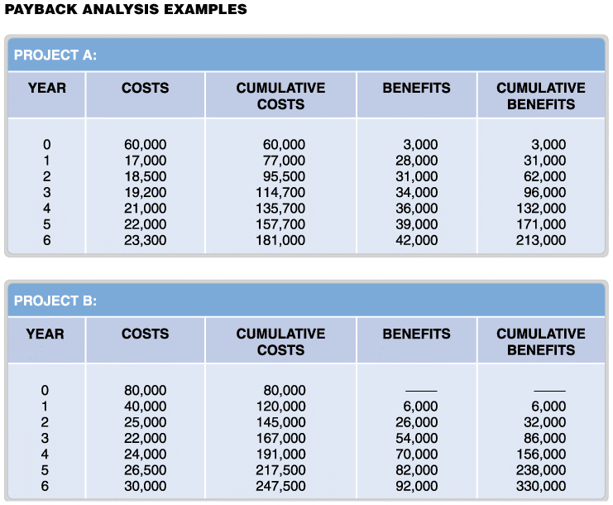
Cost-Benefit Analysis (Cont.)
FIGURE TK C-7 Payback analysis data for two information systems proposals: Project A
and Project B

Slide 17
Cost-Benefit Analysis (Cont.)
Using a Spreadsheet to Compute Payback Analysis
After entering the cost and benefit data for each year, you need a formula to display cumulative totals, year by year
For example, the first year in the cumulative costs column is the same as Year 0 costs, so the formula in cell C6 is =B6
The cumulative cost total for the second year is Year 0 cumulative total + Year 1 costs, so the formula for cell C7 is =C6+B7, and so on

Slide 18
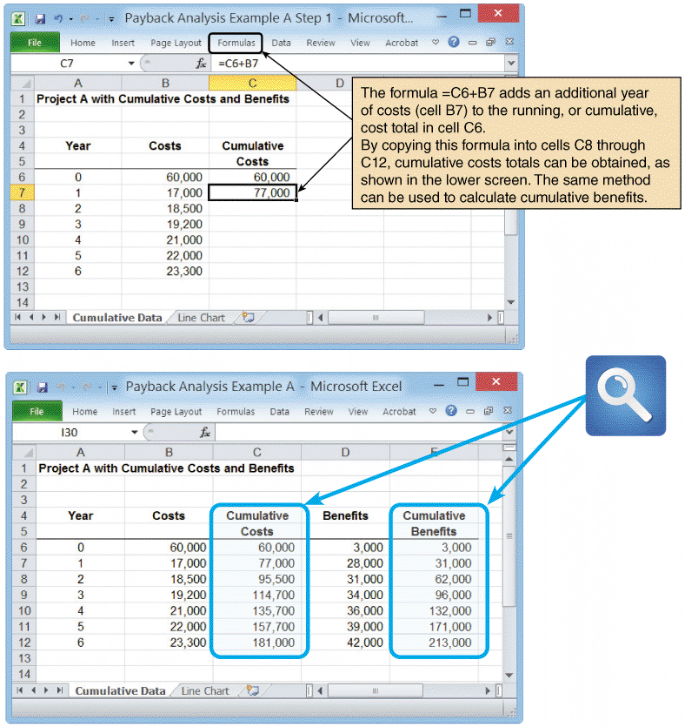
Cost-Benefit Analysis (Cont.)
FIGURE TK C-8 A Microsoft Excel worksheet displays payback analysis data for Project A in the upper screen. When cumulative cost and benefit formulas are entered, the finished worksheet in the
lower screen appears.

Slide 19
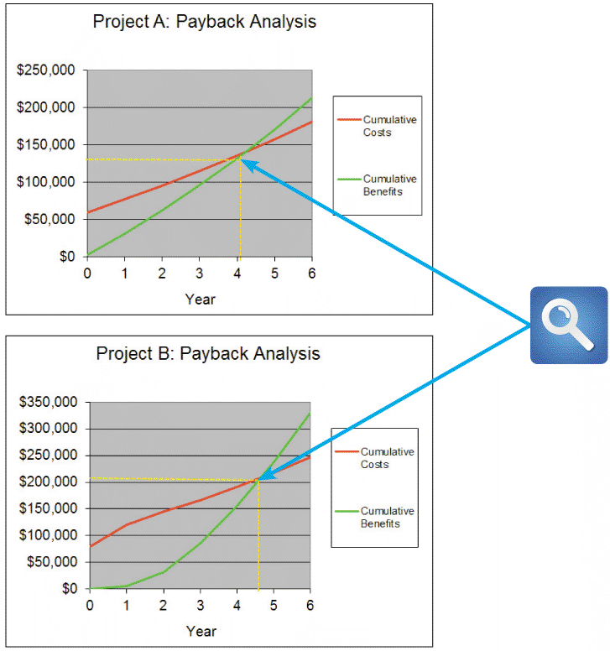
Cost-Benefit Analysis (Cont.)
FIGURE TK C-9 Microsoft Excel can be used to show the payback period by creating a chart of cumulative costs and benefits. Note that Project A has a shorter
payback period than Project B

Slide 20
Cost-Benefit Analysis (Cont.)
Return on Investment Analysis
Return on investment (ROI) is a percentage rate that measures profitability by comparing the total net benefits (the return) received from a project to the total costs (the investment) of the project
ROI is calculated as follows:
ROI = (total benefits – total costs) / total costs
Return on investment analysis considers costs and benefits over a longer time span than payback analysis
ROI calculations usually are based on total costs and benefits for a period of five to seven years

Slide 21
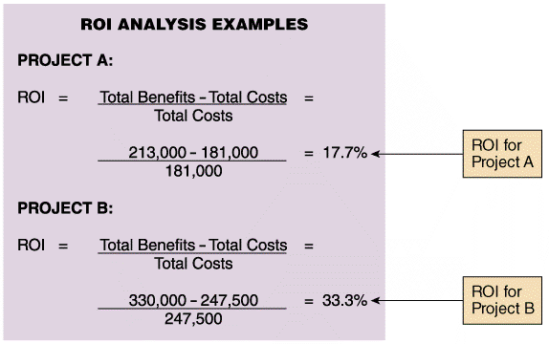
Cost-Benefit Analysis (Cont.)
FIGURE TK C-10 Return on investment analysis for Project A and Project B shown in Figure TK C-7 on page 608

Slide 22
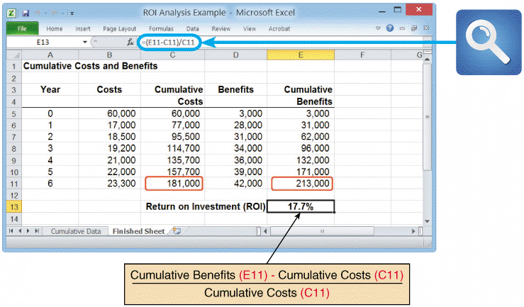
Cost-Benefit Analysis (Cont.)
Using a Spreadsheet to Compute ROI
FIGURE TK C-11 Sample ROI worksheet. Notice that cell E13 contains the ROI formula

Slide 23
Cost-Benefit Analysis (Cont.)
Present Value Analysis
A dollar you have today is worth more than a dollar you do not receive until one year from today
If you have the dollar now, you can invest it and it will grow in value
Would you rather have $100 right now or a year from now?
If you receive the $100 now, you can invest it in a mutual fund that has an annual return of 8%. One year from now, you will have $108 instead of $100

Slide 24
Cost-Benefit Analysis (Cont.)
Present Value Analysis (Cont.)
You might decide to approach ROI from a different direction
For example, instead of asking, “How much will my $100 be worth a year from now?” you can ask, “How much do I need to invest today, at 8%, in order to have $100 a year from now?”
This concept is known as the time value of money
The present value of a future dollar is the amount of money that, when invested today at a specified interest rate, grows to exactly one dollar at a certain point in the future

Slide 25
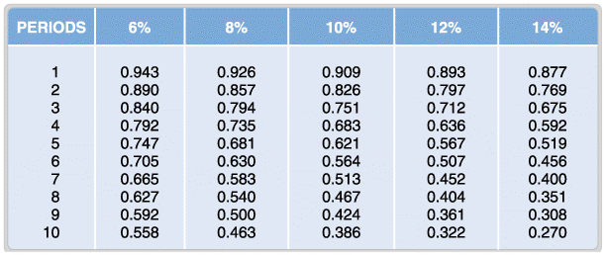
Cost-Benefit Analysis (Cont.)
FIGURE TK C-12 Portion of a present value table showing adjustment factors for various time periods and discount rates. Values in the table are calculated using the formula shown in the text. Notice how the factors decrease as time and percentages increase.

Slide 26
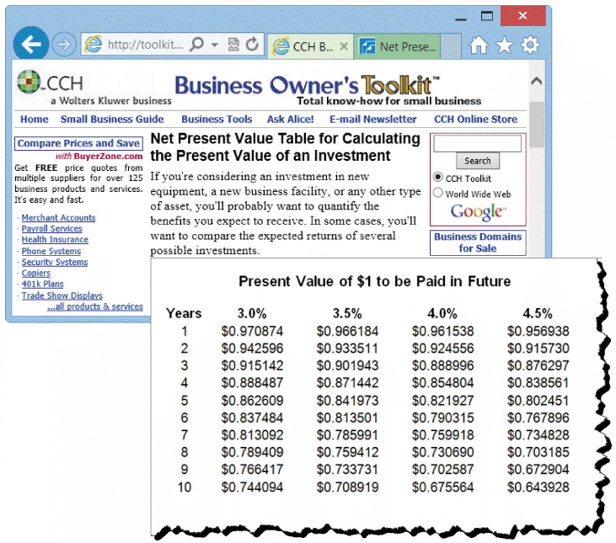
Cost-Benefit Analysis (Cont.)
FIGURE TK C-13 The CCH Business Owner’s Toolkit offers a small business guide, and a
wide range of financial tools, including this present value table

Slide 27
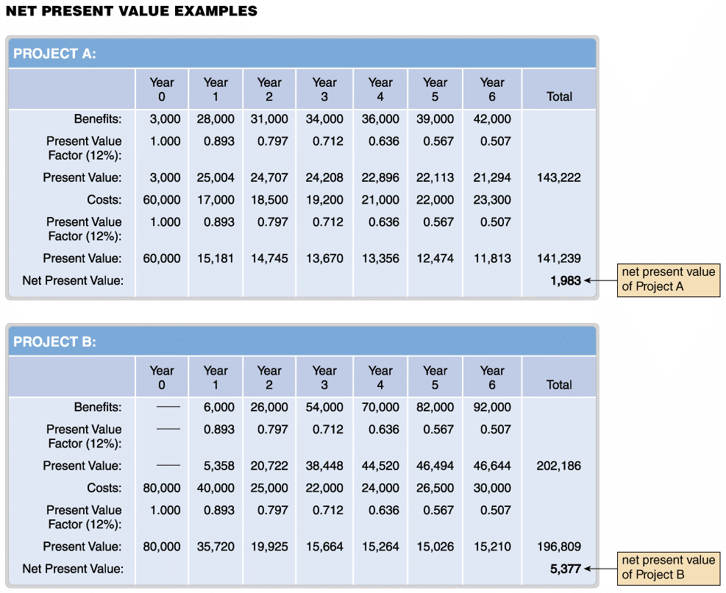
Cost-Benefit Analysis (Cont.)
FIGURE TK C-14 Net present value analysis for Project A and Project B. The tables use discount factors from external sources, such as the CCH site shown in Figure TK C-13 on the previous page

Slide 28
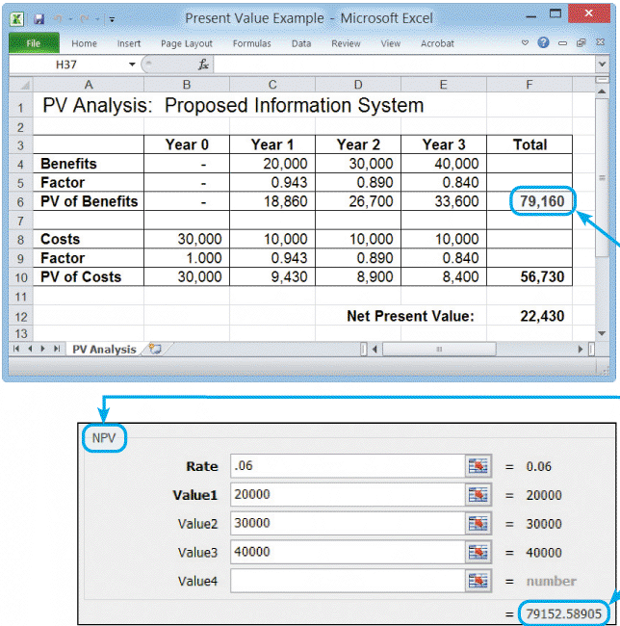
Cost-Benefit Analysis (Cont.)
Using a Spreadsheet to Calculate Present Value
Using External Factors
NPV Formula
FIGURE TK C-15 The top screen shows how to use discount factors to calculate present value in a Microsoft Excel spreadsheet. In this case, the present value of benefits is $79,160. The bottom screen shows an example of the NPV function, which is a menu-driven formula that is built into Excel. The slight difference between the values is because Excel uses more decimal places.

Slide 29
Toolkit Summary
As a systems analyst, you must be concerned with economic feasibility throughout the SDLC, and especially during the systems planning and systems analysis phases
You must classify project costs as tangible or intangible, direct or indirect, fixed or variable, and developmental or operational
Common chargeback approaches are no charge, a fixed charge, a variable charge based on resource usage, or a variable charge based on volume

Slide 30
Chapter Summary (Cont.)
Classify system benefits as tangible or intangible, fixed or variable, direct or indirect, and positive or cost-avoidance
Cost-benefit analysis involves three common approaches: payback analysis, return on investment (ROI) analysis, and present value analysis
Payback analysis determines the time it takes for a system to pay for itself, which is called the payback period
Return on investment (ROI) analysis measures a system by comparing total net benefits (the return) to total costs (the investment)

Slide 31
Chapter Summary (Cont.)
Present value analysis adjusts the value of future costs and benefits to account for the time value of money
Present value analysis uses mathematical factors that you can derive or look up in published tables
Many companies use present value analysis to evaluate and rank projects

